Slide 1



Analysis of Unemployment Rates and S&P 500 Performance
Makaela, Lexi, Braden

Slide 2

Research Questions
How do fluctuations in unemployment rates across various demographic groups correlate with the performance of the S&P 500 index?
1
2
If S&P is increasing or decreasing, which demographic is most closely related to the S&P performance?

Slide 3

Data sources & Preparation
Web Scraping (Selenium):
Website Access: Used Selenium WebDriver to open and navigate to the Bureau of Labor Statistics website.
Table Extraction: Clicked "Show table" to reveal data and extracted unemployment rates for various demographics (Total, Men, Women, Teen, White, Black, Asian, Hispanic)
Data Structuring
Data Storage: Extracted data stored in lists for each demographic group.
Data Frame Creation: Combined lists into a pandas DataFrame with columns:
-Month-Year, Total Rate, Male Rate, Female Rate, Teen Rate, White Rate, Black Rate, Asian Rate, Hispanic Rate.
Data Transformation
Date Conversion: Converted Month column to datetime format for time-based analysis.
Numeric Conversion: Converted unemployment rate columns to numeric values using pd.to_numeric(), handling errors with coerce to convert invalid data to NaN.
Data Inspection
Data Sources:
S&P 500 Data Import: Loaded S&P 500 data (spy.csv) into a pandas DataFrame.
Data Preview: Verified the first 10 rows of both data sets to ensure correct loading and format.
Civilian Unemployment Data
S&P 500 Index Data

Slide 4

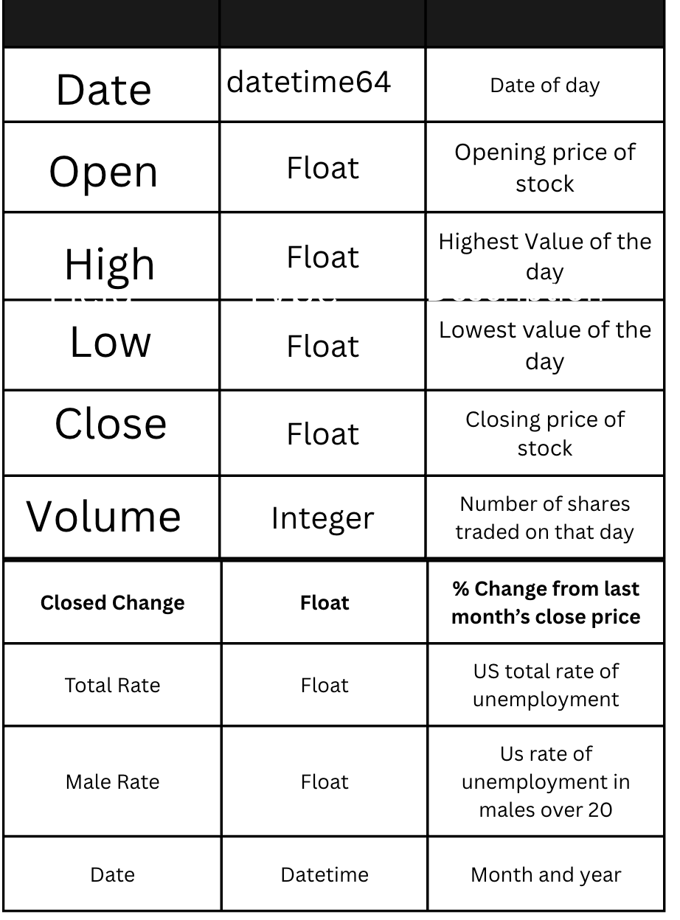
Data Dictionary

Slide 5
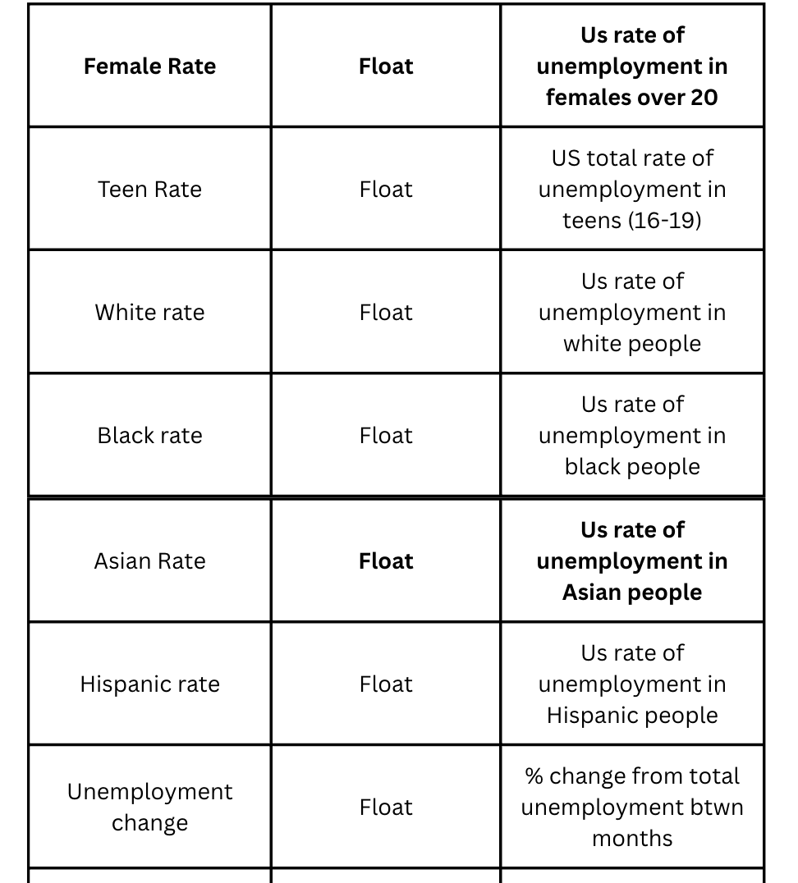
Data Dictionary cont.

Slide 6
Univariate Analysis Analyze individual demographic groups and S&P 500 performance
Total Rate:
Mean: 5.89% (Average unemployment rate across all groups)
Median: 5.0% (Midpoint of unemployment rates)
Std. Dev.: 2.27% (Indicates moderate variability)
Range: 3.5% (min) to 14.8% (max) (Shows significant fluctuation)
Skewness: 1.12 (Positively skewed, meaning more frequent lower unemployment rates)
Kurtosis: 0.80 (Moderately peaked distribution)
Male Rate:
Mean: 5.58%
Median: 4.5%
Std. Dev.: 2.31%
Range: 3.2% (min) to 13.0% (max)
Skewness: 1.02 (Slightly positively skewed)
Kurtosis: -0.11 (Close to normal distribution, slight flatness)
Female Rate:
Mean: 5.26%
Median: 4.5%
Std. Dev.: 2.09%
Range: 3.1% (min) to 15.5% (max)
Skewness: 1.66 (Strong positive skew, indicating higher unemployment at certain times)
Kurtosis: 4.27 (Leptokurtic distribution, with more extreme outliers)
Black Rate:
Mean: 9.14%
Median: 8.8%
Std. Dev.: 3.55%
Range: 4.3% (min) to 24.0% (max)
Skewness: 0.90 (Slight positive skew)
Kurtosis: -0.69 (Flat distribution)
Asian Rate:
Mean: 4.98%
Median: 4.6%
Std. Dev.: 1.76%
Range: 2.1% (min) to 12.4% (max)
Skewness: 0.67 (Slight positive skew)
Kurtosis: -0.29 (Flat distribution)
Hispanic Rate:
Mean: 6.58%
Median: 6.2%
Std. Dev.: 3.28%
Range: 3.2% (min) to 17.9% (max)
Skewness: 0.73 (Slight positive skew)
Kurtosis: -0.36 (Flat distribution)
White Rate:
Mean: 5.24%
Median: 4.35%
Std. Dev.: 2.11%
Range: 3.0% (min) to 13.9% (max)
Skewness: 1.09 (Positively skewed)
Kurtosis: -0.32 (Close to normal distribution)

Slide 7
Bivariate Analysis Investigate the relationship between demographic group unemployment rates and S&P 500 performance.
Correlation Analysis for each demographic with S&P Closing Price:
Men (>20 years): -0.4839835950963271
Women (>20 years): -0.4705614069993752
16 – 19 years: -0.41239920160502946
White: -0.4633225636409107
Black/ African American: -0.6404684208261383
Asian: -0.26420834195524995
Hispanic/ Latino: -0.45506564433412067
Interpretation: What do the correlation results suggest about the relationship between the variables?
There is very little to no correlation between S&P 500 Closing price and unemployment rates.
Regression Analysis:
Coefficients: 381.754559
P- Values: 3.686182e-30
R- Squared: 0.23424012032236563

Slide 8

Hypothesis Test
Hypothesis statement: There is no significant difference between the average unemployment rate for men and the average high value of the S&P 500 index.
Results: Reject H0: The average values are significantly different between unemployment and SP500 Highs.

Slide 9
Hypothesis Test
Hypothesis statement: There is no significant linear correlation between the female unemployment rate and the S&P 500 High values.
Results: Significant correlation exists.

Slide 10
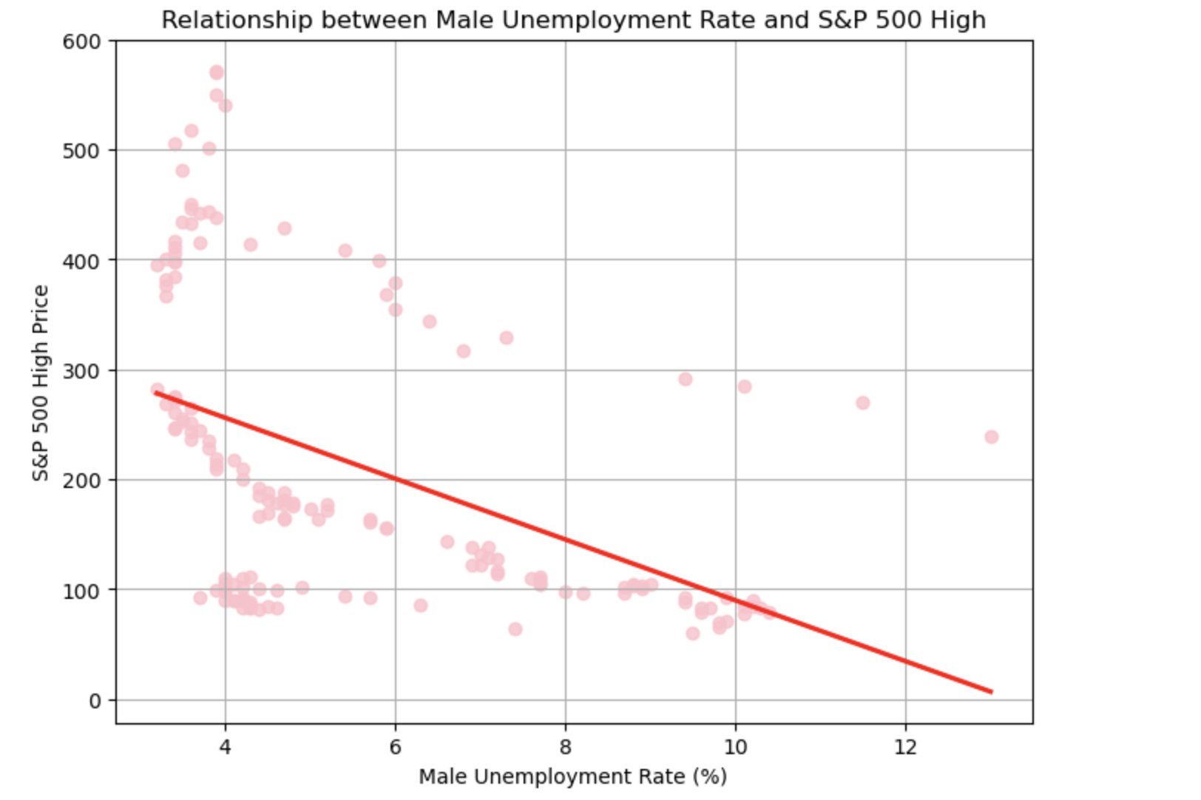
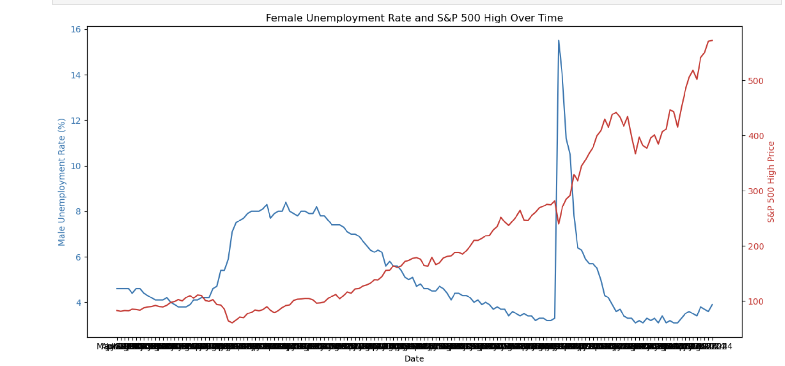
Visualization 1
Visualization 2

Slide 11
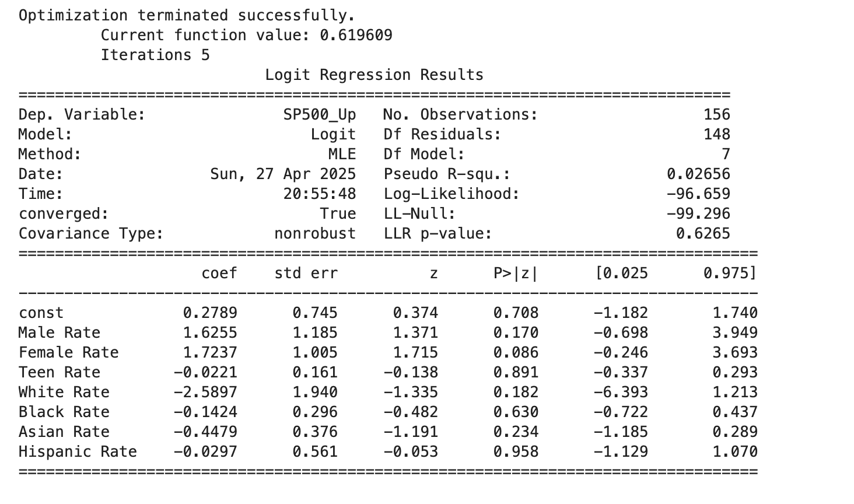
Machine Learning (Logistic Regression)

Slide 12

Service
Contact
Potential problems
· Human Error:
Data entry mistakes, misalignment of dates between datasets (S&P 500 and unemployment data).
· Low R-squared, High P-values:
Models may show weak relationships; unemployment rates alone may not strongly predict market movements.
· Socio-Economic Factors Not Captured:
External factors like government policy changes, global events, and inflation rates are not included but could heavily influence both unemployment and the stock market.
· Time Lag Effect:
Changes in unemployment may not immediately affect the S&P 500; there could be a delay not captured without time series adjustments (like lag variables).
· Limited Data Size:
If using monthly data for a few years, there may be a small sample size, which limits statistical power.

Slide 13


Road Map
We will continue to solve the questions one at a time
We will meet with either Prof Redmond or Mahan sometime this coming week
Planned work session on Thursday
Soft group assigned deadline of Monday, April 4th

